Slide 1
Elements of cost

Slide 2
Three elements of cost
1. Materials
2. Labor
a. Direct labor b. Indirect labor
3. Burden
a. Direct burden b. Fixed burden

Slide 3
Materials : based on the needs expressed in the production forecast , the purchasing department negotiates contracts and price arrangement and ascertain the standard cost of each item.
Monthly price variance report : not only measures the effectiveness of purchasing but also monitors changes in cost.
The purchase price variance report helps to pick out favorable and unfavorable price variance.

Slide 4
Purchase price variance report
Purchasing by Division A
Raw material Purchase | I Quarter | II Quarter
Actual spending | 52500 Rs | 44000 Rs
Budgeted Spending | 50000 Rs | 50000 Rs
Variance % variance | 2500 Rs 8.3 % | Rs -20 %

Slide 5
The report described in this section is helpful to both purchasing and production department. , accounting dept an management of the company.

Slide 6
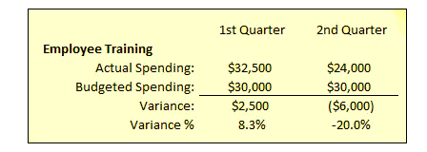
2. Labor
a. Direct labor : Labor force are important for cost control and for the stability and happiness of the workforce.
The No. of Hours required for each dept for production of most item are decided by historical information or by time study of industrial engineer .
Training cost

Slide 7
EX: The production of any bulk or finished goods items is expressed as No. of direct labor hours needed to produce 1000 bulk tablets of 100 mg or 1000 bottles of 100 ml for every product made including promotional items .
Information is important to
1. accounting dept
2. production planning dept.
3.operating managers

Slide 8
2. Indirect Labor :
without indirect labor hours it would be difficult to analyze and control available hours of work and to use labor force efficiently.
EX: If servicemen brings caps and bottles of 3 packaging line his function represent some indirect labor to each of the line. It would be best to allocate such time to the products of each line . Rather than putting cost on indirect labor and loose its identity and deviding the cost on rest of the products .

Slide 9
Indirect labor cost can not be put into work standard and can be identified and controlled.
Cost of mechanics
Cost of servicemen
Cost of equipment cleaning
Q.C Inspectors
Line change over
Every efforts are made to lower indirect labor cost to total labor for good cost control .

Slide 10
3. Burden
Direct Burden :
expenditure on
training
supervision and clerical help
lost time
premium on over time
vacation , holiday , sick pay
employee benefits as Hospitalization , Insurance, Retirement benefits.
Operating expenses of each dept .
[ uniform , maintenance , travel , membership , seminars ]
Ex: cost of Et. Oxide and HEPA in sterilization – repairs and maintaenace .

Slide 11
b. Fixed Burden
In addition to operating dept all other dept as Q.C , Material Management prepare operating expense and labor cost to be charged in the manufacturing cost..
in addition
cost of fuel , taxes , land , electricity , building and equipment depreciation
Ex: if some dept have facility of rabbits test for pyrogen testing then the cost can be allocated to parenterals dept.
it avoided spreading the cost of pyrogen testing to other dept over other cost centers which do not use this service.

Slide 12
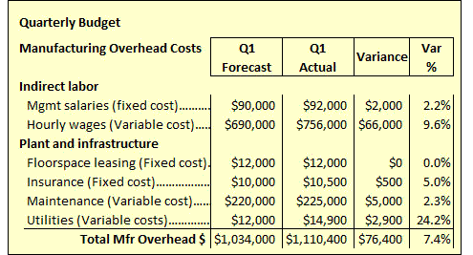
Elements of cost

Slide 13
Thank You

